Slide 1

Design patterns
What Is A Pattern?
Current use comes from the work of the architect Christopher Alexander
Alexander studied ways to improve the process of designing buildings and urban areas
“Each pattern is a three-part rule, which expresses a relation between a certain context, a problem and a solution.”
Hence, the common definition of a pattern: “A solution to a problem in a context.”
Patterns can be applied to many different areas of human endeavor, including software development
24-3月-20

Slide 2
Design patterns
A design pattern is a way of reusing abstract knowledge about a problem and its solution.
A pattern is a description of the problem and the essence of its solution.
Pattern descriptions usually make use of object-oriented characteristics such as inheritance and polymorphism.
Chapter 7 Design and implementation

Slide 3
Why Patterns?
"Designing object-oriented software is hard and designing reusable object-oriented software is even harder." - Erich Gamma
Experienced designers reuse solutions that have worked in the past
Well-structured object-oriented systems have recurring(可再现的) patterns of classes and objects
Knowledge of the patterns that have worked in the past allows a designer to be more productive and the resulting designs to be more flexible and reusable
24-3月-20

Slide 4
GoF Design Patterns
The GoF design patterns are in the middle of these levels of abstraction
The GoF design patterns are “descriptions of communicating objects and classes that are customized to solve a general design problem in a particular context.”
24-3月-20

Slide 5
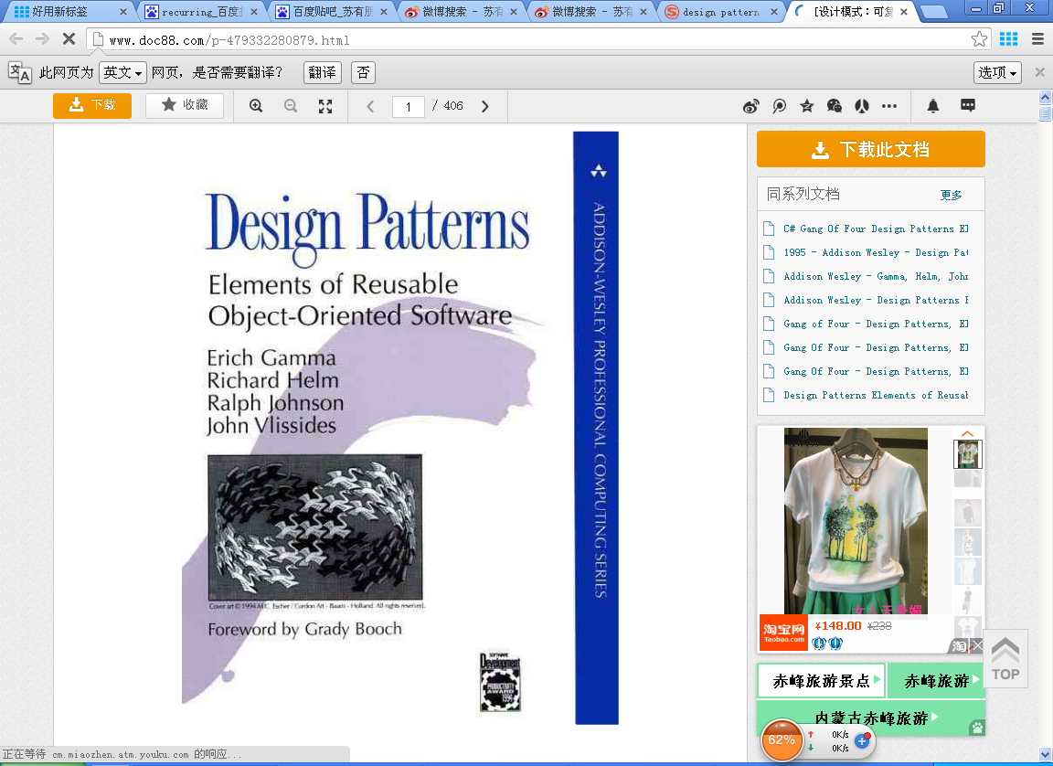

Slide 6
GoF Essential Elements of Design Patterns
Pattern Name
Having a concise, meaningful name for a pattern improves communication among developers
Problem
What is the problem and context where we would use this pattern?
What are the conditions that must be met before this pattern should be used?
24-3月-20

Slide 7
GoF Essential Elements of Design Patterns (Cont.)
Solution
A description of the elements that make up the design pattern
Emphasizes their relationships, responsibilities and collaborations
Not a concrete design or implementation; rather an abstract description
Consequences
The results of using the pattern
Includes impacts on reusability, portability, extensibility
24-3月-20

Slide 8
The Observer pattern (1)
Pattern name | Observer
Description | Separates the display of the state of an object from the object itself and allows alternative displays to be provided. When the object state changes, all displays are automatically notified and updated to reflect the change.
Problem description | In many situations, you have to provide multiple displays of state information, such as a graphical display and a tabular display. Not all of these may be known when the information is specified. All alternative presentations should support interaction and, when the state is changed, all displays must be updated. This pattern may be used in all situations where more than one display format for state information is required and where it is not necessary for the object that maintains the state information to know about the specific display formats used.
Chapter 7 Design and implementation

Slide 9
The Observer pattern (2)
Pattern name | Observer
Solution description | This involves two abstract objects, Subject and Observer, and two concrete objects, ConcreteSubject and ConcreteObject, which inherit the attributes of the related abstract objects. The abstract objects include general operations that are applicable in all situations. The state to be displayed is maintained in ConcreteSubject, which inherits operations from Subject allowing it to add and remove Observers (each observer corresponds to a display) and to issue a notification when the state has changed. The ConcreteObserver maintains a copy of the state of ConcreteSubject and implements the Update() interface of Observer that allows these copies to be kept in step. The ConcreteObserver automatically displays the state and reflects changes whenever the state is updated.
Consequences | The subject only knows the abstract Observer and does not know details of the concrete class. Therefore there is minimal coupling between these objects. Because of this lack of knowledge, optimizations that enhance display performance are impractical. Changes to the subject may cause a set of linked updates to observers to be generated, some of which may not be necessary.
Chapter 7 Design and implementation

Slide 10
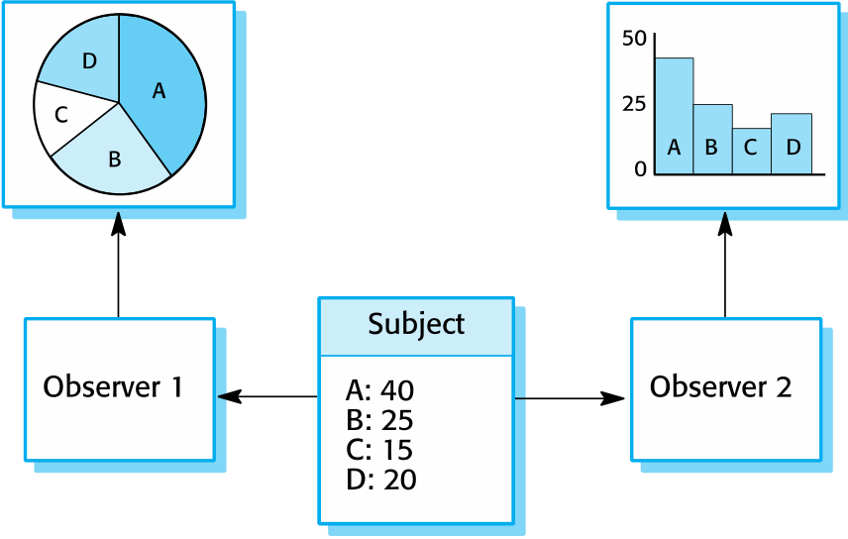
Multiple displays using the Observer pattern
Chapter 7 Design and implementation

Slide 11
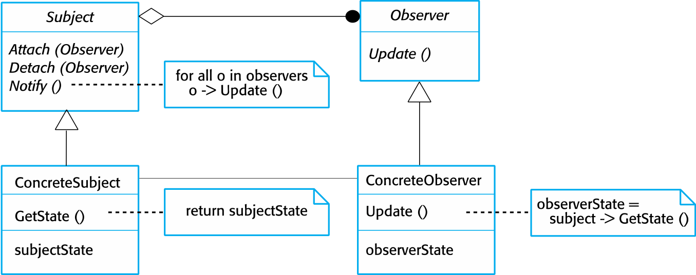
A UML model of the Observer pattern
Chapter 7 Design and implementation

Slide 12
The Composite Pattern
Intent
Compose objects into tree structures to represent part-whole hierarchies.
Composite lets clients treat individual objects and compositions of objects uniformly.
This is called recursive composition.
24-3月-20

Slide 13
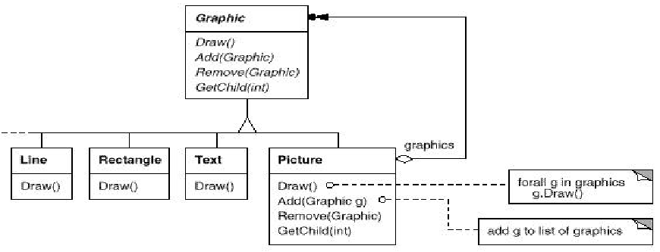
Motivation
24-3月-20

Slide 14
Applicability
Use the Composite pattern when
You want to represent part-whole hierarchies of objects
You want clients to be able to ignore the difference between compositions of objects and individual objects.
Clients will treat all objects in the composite structure uniformly.
24-3月-20

Slide 15
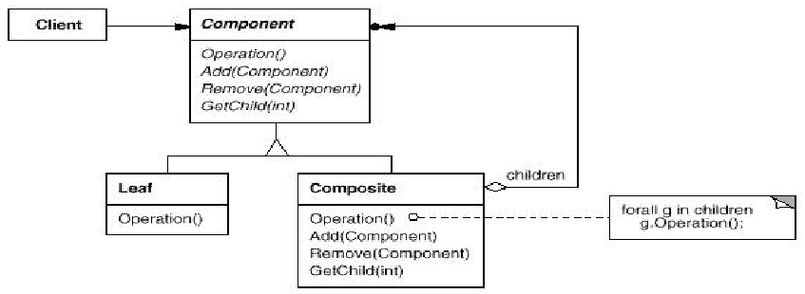
Structure
24-3月-20

Slide 16
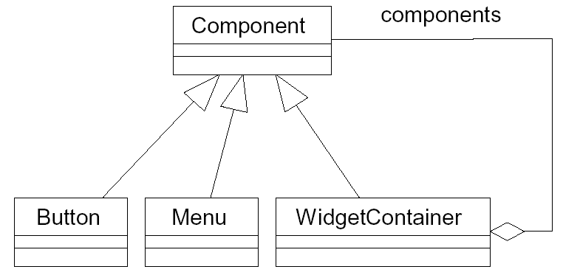
Eg.
Chapter 7 Design and implementation

Slide 17
Implementation issues
Focus here is not on programming, although this is obviously important, but on other implementation issues that are often not covered in programming texts:
Reuse Most modern software is constructed by reusing existing components or systems. When you are developing software, you should make as much use as possible of existing code.
Configuration management During the development process, you have to keep track of the many different versions of each software component in a configuration management system.
Host-target development Production software does not usually execute on the same computer as the software development environment. Rather, you develop it on one computer (the host system) and execute it on a separate computer (the target system).
Chapter 7 Design and implementation

Slide 18
Reuse levels
The abstraction level
At this level, you don’t reuse software directly but use knowledge of successful abstractions in the design of your software.
The object level
At this level, you directly reuse objects from a library rather than writing the code yourself.
The component level
Components are collections of objects and object classes that you reuse in application systems.
The system level
At this level, you reuse entire application systems.
Chapter 7 Design and implementation

Slide 19
Configuration management
Configuration management is the name given to the general process of managing a changing software system.
Version management, where support is provided to keep track of the different versions of software components.
System integration, where support is provided to help developers define what versions of components are used to create each version of a system.
Problem tracking, where support is provided to allow users to report bugs and other problems, and to allow all developers to see who is working on these problems and when they are fixed.
See also Chapter 25.
Chapter 7 Design and implementation

Slide 20
Host-target development
Most software is developed on one computer (the host), but runs on a separate machine (the target).
More generally, we can talk about a development platform and an execution platform.
A platform is more than just hardware.
It includes the installed operating system plus other supporting software such as a database management system or, for development platforms, an interactive development environment.
Software development tools are often grouped to create an integrated development environment (IDE).
An IDE is a set of software tools that supports different aspects of software development, within some common framework and user interface.
Chapter 7 Design and implementation

Slide 21
Open source development
Open source development is an approach to software development in which the source code of a software system is published and volunteers are invited to participate in the development process
Its roots are in the Free Software Foundation (www.fsf.org), which advocates that source code should not be proprietary but rather should always be available for users to examine and modify as they wish.
Open source software extended this idea by using the Internet to recruit a much larger population of volunteer developers. Many of them are also users of the code.
Chapter 7 Design and implementation
Notes:
Proprietary:专利

Slide 22
Open source systems
The best-known open source product is, of course, the Linux operating system which is widely used as a server system and, increasingly, as a desktop environment.
Other important open source products are Java, the Apache web server and the mySQL database management system.
Chapter 7 Design and implementation

Slide 23
Open source issues
Should the product that is being developed make use of open source components?
Should an open source approach be used for the software’s development?
Chapter 7 Design and implementation

Slide 24
Open source business
More and more product companies are using an open source approach to development.
Their business model is not reliant on selling a software product but on selling support for that product.
They believe that involving the open source community will allow software to be developed more cheaply, more quickly and will create a community of users for the software.
Chapter 7 Design and implementation

Slide 25
Key points
Software design and implementation are inter-leaved activities. The level of detail in the design depends on the type of system and whether you are using a plan-driven or agile approach.
The process of object-oriented design includes activities to design the system architecture, identify objects in the system, describe the design using different object models and document the component interfaces.
A range of different models may be produced during an object-oriented design process. These include static models (class models, generalization models, association models) and dynamic models (sequence models, state machine models).
Component interfaces must be defined precisely so that other objects can use them. A UML interface stereotype may be used to define interfaces.
Chapter 7 Design and implementation

Slide 26
Key points
When developing software, you should always consider the possibility of reusing existing software, either as components, services or complete systems.
Configuration management is the process of managing changes to an evolving software system. It is essential when a team of people are cooperating to develop software.
Most software development is host-target development. You use an IDE on a host machine to develop the software, which is transferred to a target machine for execution.
Open source development involves making the source code of a system publicly available. This means that many people can propose changes and improvements to the software.
Chapter 7 Design and implementation

